Slide 1
Orientation Meeting
Cert IV in Medical Practice Assisting HLT47715

Slide 2
UNE Partnerships MPA Team
Academic Director: Cathy Baynie
Trainer and Assessor: Vicki Conomy
Trainer and Assessor: Cathy Baynie
Trainer and Assessor: Helen Storer
Assessor: Gary Smith
Assessor: Cat Ryan
Program Manager: Margaret Kirby
Student Engagement: Kate Charles and Maddie Horneman

Slide 3
Congratulations, you are a pioneer in Healthcare!
Cert IV in Medical Practice Assisting:
23 Units of competency in 3 distinct terms
Blended delivery, with 7 days Face to Face training in practical skills
Webinar interactive coaching and online materials and assessments
Workplace supported, with practical skills being demonstrated and observed in your workplace and observed by a registered medical practitioner.
Your progress is supported by your allocated Assessor and Student Engagement Officer.

Slide 4
My Schedule Term 1 Online Healthcare
Unit | Code | Name | Duration
1 | HLTHPS005 | Handle medical specimens | 3 weeks
2 | CHCDIV001 | Work with diverse people | 4 weeks
3 | CHCLEG001 | Work legally and ethically | 4 weeks
4 | HLTHPS003 | Maintain medication stocks | 3 weeks
5 | HLTADM003 | Facilitate a coordinated approach to client care | 4 weeks
Units 1 – 5:
These require you to complete Tasks such as knowledge quizzes, short answer responses, long answer assignments, research reports and clinical sign offs.
Coaching webinar: is a time to check in with your Assessor, ask any questions you may have, hear how other students are progressing and discuss how to manage your workplace sign offs.
Units 6 – 8:
First Aid courses are delivered via Face to Face Workshops by the Surf Lifesaving in your State e.g. SLTS in Tasmania. We do this because they are experts in First Aid. SL will send UNEP the assessments and paperwork, then we will update your student record. If you need a Statement of Attainment for accreditation, please request a copy.
Webinar – Distance Learning Coaching (1 hour)
Offline by Workshop at a mutually convenient date
6 | HLTAID003 | Provide First Aid | Face to Face Workshop delivered by Surf Life Saving NSW
7 | HLTAID006 | Provide Advanced First Aid
8 | HLTAID008 | Manage First Aid services and resources

Slide 5
My Schedule Term 2 Clinical Health
Units 9 – 11:
These are Clinical workshop and large medical units. Full detailed demonstration instruction will be given in the workshop. Your trainer will be signing off on your skills demonstrated. You will therefore, need to bring your printed clinical skills assessment tasks. You will then go into your workplace and organise with clinicians to demonstrate the skills and ask them to sign off that they have observed you performing them.
Coaching webinar: is a time to check in with your Assessor, ask any questions you may have, hear how other students are progressing and discuss how to manage your workplace sign offs.
Unit 12:
Is a distance learning subject, online assessment tasks.
Units 13 – 15:
As above for units 9 to 11. These are clinical workshop units and take approximately 5 weeks each.
Unit | Code | Name | Duration
9 | HLTHPS001 | Take clinical measurements | 5 weeks
10 | HLTINF002 | Process re-useable medical devices and equipment | 5 weeks
11 | HLTCAR001 | Perform electrocardiography (ECG) | 5 weeks
Webinar – Distance Learning Coaching (1 hour)
12 | HLTHWS003 | Maintain work health and safety | 3-4 weeks
13 | HLTINF001 | Comply with infection prevention and control policies and procedures | 5 weeks
14 | HLTAAP002 | Confirm physical health status | 5 weeks
15 | HLTHPS002 | Support health professional in the delivery of care | 5 weeks

Slide 6
My Schedule Term 3 Business of Healthcare
Unit | Code | Name | Duration
16 | BSBMED301 | Interpret and apply medical terminology appropriately | 3-4 weeks
17 | BSBFLM309 | Support continuous improvement systems and processes | 4 weeks
18 | CHCCOM005 | Communicate and work effectively in health or community services | 6 weeks
19 | BSBINM401 | Implement workplace information system | 4 weeks
Units 16 – 23:
These are online business units in health practice management.
These units each require online assessment tasks and mangers sign off.
You may do them in any order you wish.
Coaching webinar: is a time to check in with your Assessor, ask any questions you may have, hear how other students are progressing and discuss how to manage your workplace sign offs.
Webinar – Distance Learning Coaching (1 hour)
20 | CHCCCS020 | Respond effectively to behaviours of concern | 6 weeks
21 | BSBADM307 | Organise schedules | 3 weeks
22 | BSBMED302 | Prepare and process medical accounts | 3-4 weeks
23 | BSBMED303 | Maintain patient records | 3-4 weeks

Slide 7
my.unep.edu.au
The first requirement in each unit is to do the online Introductory Quiz
Once you attempt the Introductory Quiz, your Assessments
and Study Materials will be released
You can Save your assessment work and
Submit is when you have
completed it for marking by your assessor
Online assessment task: Knowledge Quiz, Short answer assignment, Long answer questions, Research tasks,
Clinical (Practical) skills and workplace supervisor reports These are printed and signed and uploaded as observation tasks.

Slide 8
Time Management
You are adult learners and are expected to complete 20 competency based assessments, over 18 months
we have divided these into 3 terms approx,
Term1 has 5 online study units, 2 webinars, it should take up to 5-6 mths
Term 2 has 7 units and 4 workshop days, 1 webinar, estimated to be 6-8 mths
Term 3 has 8 online business units, 1 webinar, estimated to be 6 mths
There are also 3 days of First Aid training, these do not have online assessments
Approximately 4-6 hours per week of reading, assessments and practical demonstrations including workshops/webinars

Slide 9
Assessment Management
As an example
Handle Medical Specimens
Has 4 assessment tasks,
Two webinars
and PPTS
To be 100% completed
Check your grades and profile (under your name) once you have completed a few tasks

Slide 10
Submitted assessments marked
Once you submit, your assessment will be waiting to be marked. Your assessor will mark it as soon as they can:
It will be marked Satisfactory or Competent
Or if not quite right it will be marked Unsatisfactory or Not Yet Competent
Please read your feedback and resubmit incorrect answers for marking by your assessor. You can Review then Reattempt.
Only registered medical practitioner (AHPRA) can sign Clinical Skills observation reports. Please record their AHPRA number
Your Manager can sign for business and community health unit sign offs.

Slide 11
my.unep.edu.au
Log into your UNEP Portal using your online learning registration details.
If you forget your password, you can click on ‘Forgot Password’ on the login page and follow the instructions:
Checkout your dashboard, It will list your:
23 units, with start dates and end dates
Show you your course
Show you your progress
Display navigation side panels
Clicking on your name (top right hand corner) has a few secret shortcuts:
Your Profile is found here
Progress wheels
Grades
When you have completed a task:
A red cross next to a Task means you are required to reattempt it
Green ticks signifies “correct”
Please read your assessor feedback

Slide 12
Dashboard
Orange – In Progress
Grey – Pending
Green – Completed
Then on the page you will see my courses, course stats, course analysis
And then at the bottom is Recent feedback with your grade and feedback summary

Slide 13
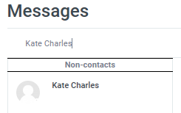
Messaging
I need to contact my assessor, how can I do this?
You can click on ‘Message My Teacher’ which is located on the top right hand side of your Portal:
Can I message my Student Engagement Officer through my Portal?
Yes – you can click on the envelope on the left hand side of your name, then type in the name of the person you would like to message:

Slide 14
Assessment Management
As an example
Handle Medical Specimens
Has 4 assessment tasks,
Two webinars
and PPTS
To be 100% completed
Check your grades and profile (under your name) once you have completed a few tasks

Slide 15
Resubmitting a Knowledge Quiz
You are required to get 100% in the Knowledge Quizzes. Expand your right hand side navigation panel to reveal what answers require review:
Green – answer is correct
Orange – answer is partially correct
Red – answer is incorrect
Then you need to re-attempt the Quiz:
Your original responses will go across into the new attempt.
Alter the incorrect answers then click Submit all and Finish.

Slide 16
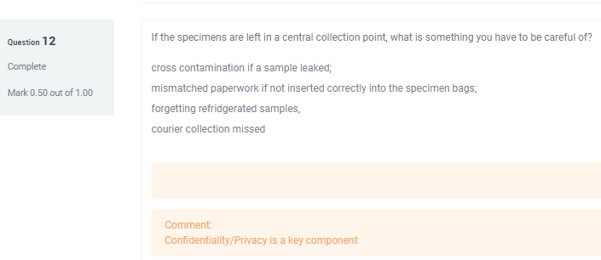
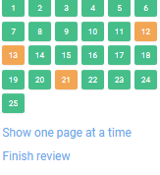
Review previous attempt, then reattempt
This answer is not 100% correct, it has been partially marked correct. It will have to be reviewed and reattempted
This student is reviewing question 12, now they will have to right click to open a new tab, reattempt the quiz, while reattempting questions 12,13 and 21 then submitting and confirming its submitted.

Slide 17
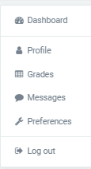
Navigation panels
The Navy bar has a lot of hidden navigation tools. Messages, Notifications and further to the right is your name
Click on it for a drop down menu of
The three bars next to the logo, slide the black navigation panel open and closed
The small blue toggle (looks like a greater than symbol) opens and closes the right hand side panel

Slide 18
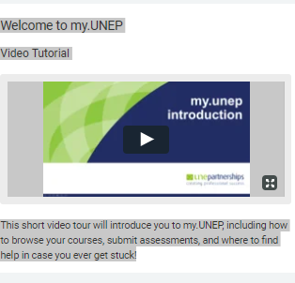
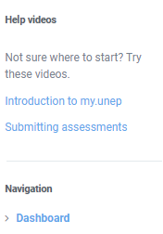
How do I know my Assessment is Submitted?
You are able to upload multiple files and save these, then your submission will be a draft:
You will see the options:
Once fully submitted, you will see the below:

Slide 19
Certificate IV in Medical Practice Assisting
This course is designed to
Give you standardised training
Give you a nationally recognised qualification
Give you protection from an indemnity perspective
If you stay within your scope of practice
Increase your skills and competence and allow you to use the title Medical Assistant
Click the audio for Cat’s Story on being a Medical Assistant

Slide 20
What type of Learner are you?

Slide 21
Study Motivation Techniques
Pomodoro technique: Pick a Task to complete, set a timer for 25 minutes, work on the task, have a 5 minute break when the timer goes off. After the fourth Pomodoro task, take a longer 15-20 minute break.
Eat the Frog: Complete the Task that you’re least looking forward to (get it out of the way).
How to eat an Elephant: Break up the Task into smaller sections and give yourself a deadline on each section:
For example, 1 unit per month, first week intro quiz, second week read study notes and knowledge quiz’s, third week short answer questions/ workplace observational report.

Slide 22
FAQ
Where are the assessment due dates?
As adult learners, we feel you are in the best position to manage your time. You are to complete 20 units of assessments. Ideally you would manage your study the units within 18 months. We have organised them into 3 distinct Terms, so these are milestones we would like you to use as guides, they are approximately 6 months each.
What if I can not attend the Workshops?
These are necessary to attend, please make other arrangements to travel to other groups workshops if you miss yours.
If this option is not available, you may have to wait for the next groups workshops. We can not predict when that will be.
What is my Scope of Practice
Medical assistants are not independent practitioners
You do not make decisions regarding the care of the patient
It is not your role to decide what investigations to order
You do not diagnose
Medical assistants are not able to handle scheduled medications
As a medical assistant you do not provide counselling services to patients unless directed by the health practitioner

Slide 23
Problems ?
Am I covered for indemnity ?
You should be , but ask your Practice to be sure. They may have to include you in the treatment room, and update your statement of duties.
What if I don’t understand the task?
Your Assessor feedback is important to help you learn and progress. Please read this, and you are able to message them through your Portal with any questions. If you need further assistance, Student Support is the best place to ask first.
If you have any issues, please contact us
Phone: (02) 6773 0000 Email: practice@unep.edu.au

